Slide 1
Happy Hour Project Presentation
September 11, 2019
William, Rebekah, Sue, Brian, Wynton

Slide 2
Overall Concept and Motivation:
The motivation behind this project was to create a working website that utilized the knowledge and skills we’ve acquired thus far in this course and to create a tool that people would enjoy using.
Develop a tool for people to easily access cocktail recipes by the title of the cocktail and to store the recipe as their favorite if desired.

Slide 3








Technologies Used:
Firebase

Slide 4
Happy Hour Design Process Diagram
Start Program
Display the favorites on screen
Upload drink to Firebase
Listen for Submit Button
Display ingredients, measures and Favorites Button
Listen for Favorites Button
Search Cocktails DB for drink choice

Slide 5
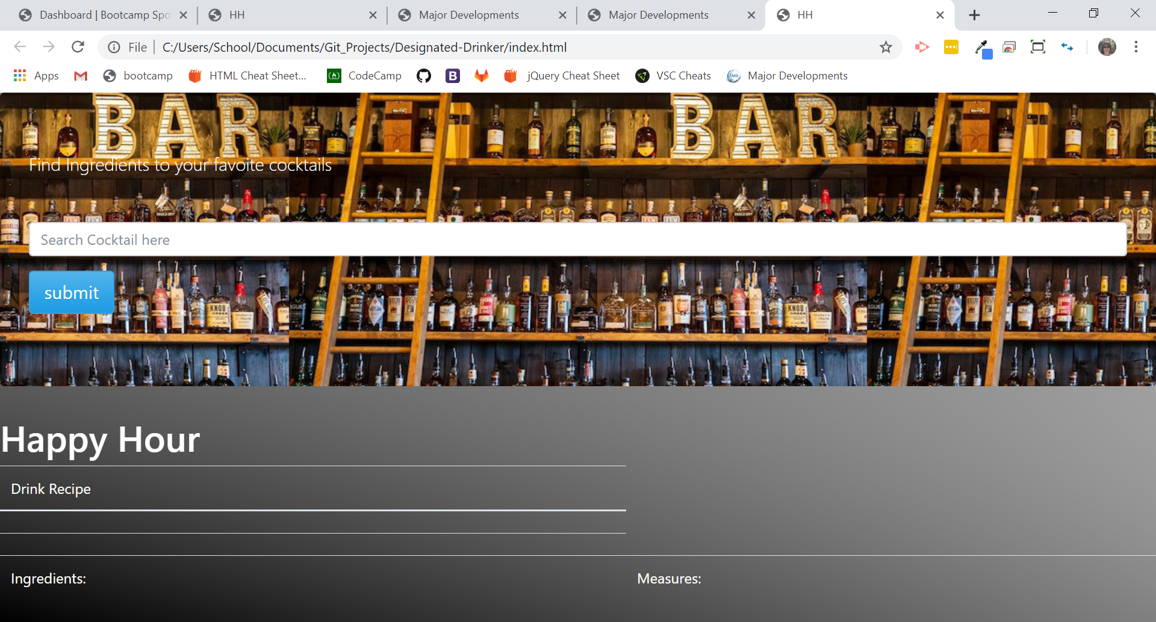

Slide 6
Future Developments:
Create a more forgiving search experience by using auto fill or auto correction for misspelled searches.
Pull up Happy Hour destinations near by using google maps.
Add taxi option (Uber, Lyft etc.).
Add a feature that allows the removal of unwanted favorites as well as duplicates.
Add the age verification.

Slide 7
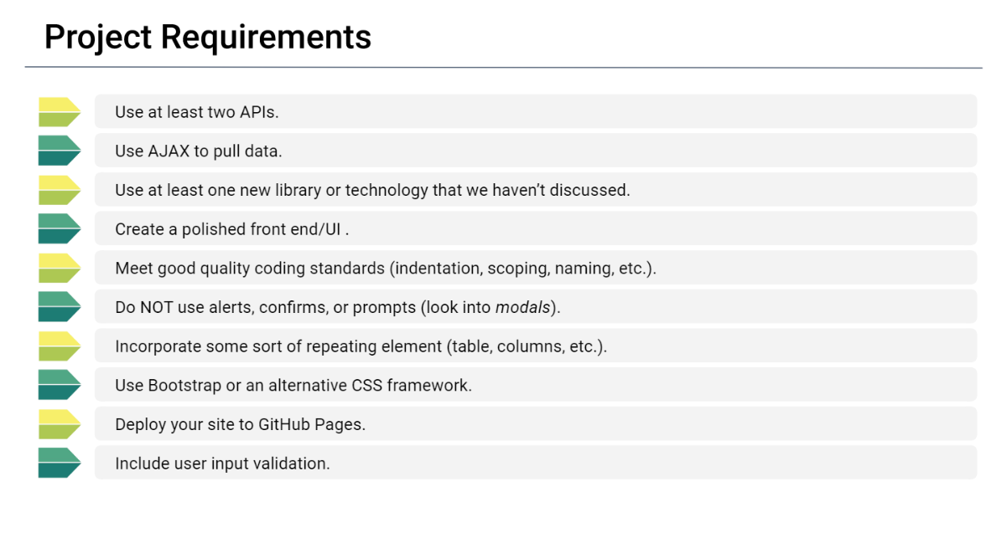


Slide 8
